Slide 1
Autoencoders

Slide 2
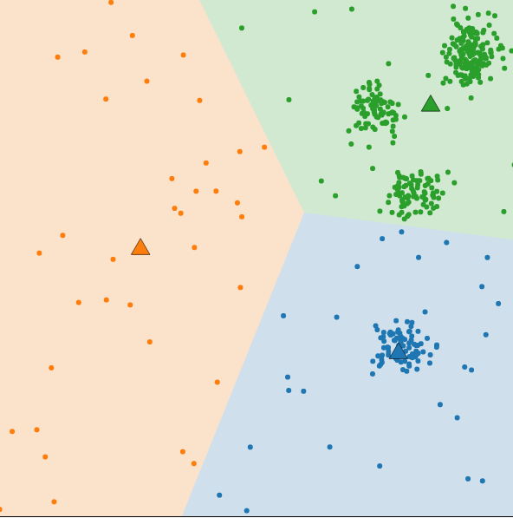
Recap of K-Means
Goal:
Partition n observations into
k clusters
Pictured: Wrong k number of clusters
Notes:
https://commons.wikimedia.org/wiki/File:Kmeans_wrongK.PNG

Slide 3
When K-Means Fails?
Scales poorly with large numbers of observations
“Curse of Dimensionality”
Pictured: Wrong k number of clusters
Notes:
https://commons.wikimedia.org/wiki/File:Kmeans_wrongK.PNG

Slide 4
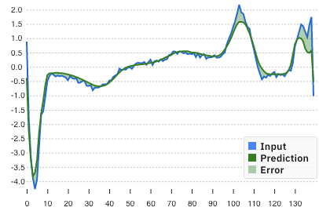
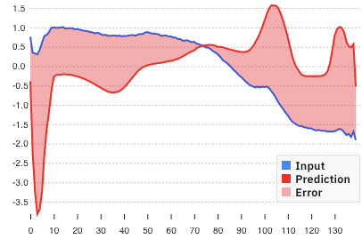
Notes:
Adds an additional challenge to training. There is far more ‘normal’ data than ‘abnormal’ but it’s critical to catch the anomaly
Always guessing no anomaly would lead to high perceived accuracy

Slide 5
You don’t know what you don’t know.

Slide 6
You don’t know what you don’t know.
But you do know what you know.

Slide 7
Ideally, they are identical.
x = x'
Reconstructed
Input
Input
Notes:
Csaba: Want to understand what's normal, one way to do that is to compress to understand the fundamental elements. Noise vs. essence

Slide 8
Ideally, they are identical.
x = x'
Reconstructed
Input
Input
Notes:
Csaba: Want to understand what's normal, one way to do that is to compress to understand the fundamental elements. Noise vs. essence

Slide 9
Ideally, they are identical.
x = x'
Reconstructed
Input
Input
x
x'
Notes:
Csaba: Want to understand what's normal, one way to do that is to compress to understand the fundamental elements. Noise vs. essence

Slide 10
Ideally, they are identical.
x = x'
Reconstructed
Input
Input
x
x'
z
Notes:
Csaba: Want to understand what's normal, one way to do that is to compress to understand the fundamental elements. Noise vs. essence

Slide 11
Ideally, they are identical.
x = x'
Reconstructed
Input
Input
x
x'
z
Compressed low dimensional representation of the input
Notes:
Csaba: Want to understand what's normal, one way to do that is to compress to understand the fundamental elements. Noise vs. essence

Slide 12
Ideally, they are identical.
x = x'
Reconstructed
Input
Input
x
x'
?
z
Compressed low dimensional representation of the input
Notes:
Csaba: Want to understand what's normal, one way to do that is to compress to understand the fundamental elements. Noise vs. essence

Slide 13
Ideally, they are identical.
x = x'
Reconstructed
Input
Input
x
x'
Encoder
z
Compressed low dimensional representation of the input
Notes:
Csaba: Want to understand what's normal, one way to do that is to compress to understand the fundamental elements. Noise vs. essence

Slide 14
Ideally, they are identical.
x = x'
Reconstructed
Input
Input
x
x'
Encoder
z
?
Compressed low dimensional representation of the input
Notes:
Csaba: Want to understand what's normal, one way to do that is to compress to understand the fundamental elements. Noise vs. essence

Slide 15
Ideally, they are identical.
x = x'
Reconstructed
Input
Input
x
x'
Encoder
z
Decoder
Compressed low dimensional representation of the input
Notes:
Csaba: Want to understand what's normal, one way to do that is to compress to understand the fundamental elements. Noise vs. essence

Slide 16
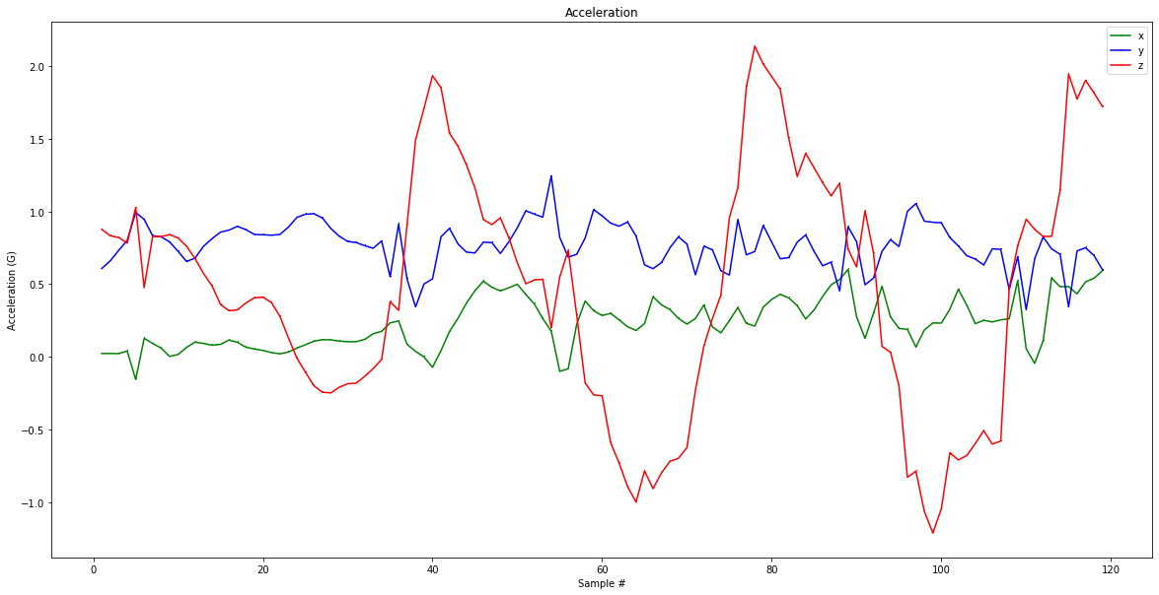
Code

Slide 17
Code
Encoder
Notes:
The encoder accepts the input data and compresses it into the latent-space representation. The decoder then attempts to reconstruct the input data from the latent space.

Slide 18
Code
Encoder
Decoder
Notes:
The encoder accepts the input data and compresses it into the latent-space representation. The decoder then attempts to reconstruct the input data from the latent space.

Slide 19
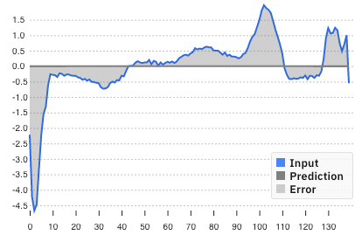
Code
Encoder
Decoder
Normal Data

Slide 20
Code
Encoder
Decoder
Normal Data
“Normal” Data
Notes:
When trained in an end-to-end fashion, the hidden layers of the network learn filters that are robust and even capable of denoising the input data.
However, what makes autoencoders so special from an anomaly detection perspective is the reconstruction loss. When we train an autoencoder, we typically measure the mean-squared-error (MSE) between:
The input image
The reconstructed image from the autoencoder The lower the loss, the better a job the autoencoder is doing at reconstructing the image.

Slide 21
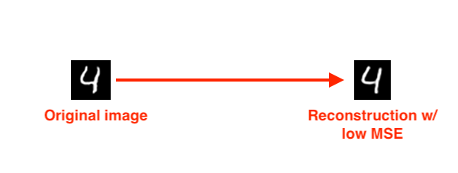
Code
Encoder
Decoder
Notes:
When trained in an end-to-end fashion, the hidden layers of the network learn filters that are robust and even capable of denoising the input data.
However, what makes autoencoders so special from an anomaly detection perspective is the reconstruction loss. When we train an autoencoder, we typically measure the mean-squared-error (MSE) between:
The input image
The reconstructed image from the autoencoder The lower the loss, the better a job the autoencoder is doing at reconstructing the image.

Slide 22
Code
Encoder
Decoder
Notes:
When trained in an end-to-end fashion, the hidden layers of the network learn filters that are robust and even capable of denoising the input data.
However, what makes autoencoders so special from an anomaly detection perspective is the reconstruction loss. When we train an autoencoder, we typically measure the mean-squared-error (MSE) between:
The input image
The reconstructed image from the autoencoder The lower the loss, the better a job the autoencoder is doing at reconstructing the image.

Slide 23
Code
Encoder
Decoder
Low Reconstruction Loss
(Low Mean Square Error)
Notes:
When trained in an end-to-end fashion, the hidden layers of the network learn filters that are robust and even capable of denoising the input data.
However, what makes autoencoders so special from an anomaly detection perspective is the reconstruction loss. When we train an autoencoder, we typically measure the mean-squared-error (MSE) between:
The input image
The reconstructed image from the autoencoder The lower the loss, the better a job the autoencoder is doing at reconstructing the image.

Slide 24
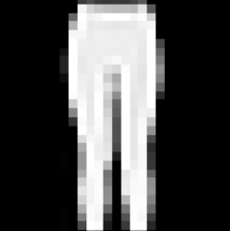
Code
Encoder
Decoder
Notes:
When trained in an end-to-end fashion, the hidden layers of the network learn filters that are robust and even capable of denoising the input data.
However, what makes autoencoders so special from an anomaly detection perspective is the reconstruction loss. When we train an autoencoder, we typically measure the mean-squared-error (MSE) between:
The input image
The reconstructed image from the autoencoder The lower the loss, the better a job the autoencoder is doing at reconstructing the image.

Slide 25
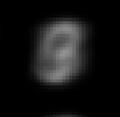
Code
Encoder
Decoder
Low Reconstruction Loss
(Low Mean Square Error)
Notes:
When trained in an end-to-end fashion, the hidden layers of the network learn filters that are robust and even capable of denoising the input data.
However, what makes autoencoders so special from an anomaly detection perspective is the reconstruction loss. When we train an autoencoder, we typically measure the mean-squared-error (MSE) between:
The input image
The reconstructed image from the autoencoder The lower the loss, the better a job the autoencoder is doing at reconstructing the image.

Slide 26
Unbalanced Data
Notes:
Adds an additional challenge to training. There is far more ‘normal’ data than ‘abnormal’ but it’s critical to catch the anomaly
Always guessing no anomaly would lead to high perceived accuracy

Slide 27
?
Error > Threshold
Code
Normal Data
“Normal” Data
Notes:
Only train on normal data

